Slide 1

중고차 가격 예측하기
이소희, 신경훈, 김준구, 윤아람, 정은서, 안은정

Slide 2
Contents
Introduction
Data processing
Machine Learning Model
Results
Conclusion

Slide 3
Introduction

Slide 4
Data
Kaggle에서 주최한 "인도 중고차 예측하기" 데이터셋의 train data를 바탕으로 중고차 가격 예측하기
https://www.kaggle.com/datasets/avikasliwal/used-cars-price-prediction
6019 rows and 14 columns
Name | Location | Year | Kilometers Driven | Fuel Type | Transmission | Owner Type | Mileage | Engine | Power | Seats | New Price | Price
Maruti Wagon R LXI CNG | Mumbai | 2010 | 72000 | CNG | Manual | First | 26.6 km/kg | 998 CC | 58.16 bhp | 5 |  | 1.75
Hyundai Creta 1.6 CRDi SX Option | Pune | 2015 | 41000 | Diesel | Manual | First | 19.67 kmpl | 1582 CC | 126.2 bhp | 5 |  | 12.5

Slide 5
Data Processing

Slide 6
Data Processing
Name | Location | Year | Kilometers Driven | Fuel Type | Transmission | Owner Type | Mileage | Engine | Power | Seats | New Price | Price
Maruti Wagon R LXI CNG | Mumbai | 2010 | 72000 | CNG | Manual | First | 26.6 km/kg | 998 CC | 58.16 bhp | 5 |  | 1.75
Hyundai Creta 1.6 CRDi SX Option | Pune | 2015 | 41000 | Diesel | Manual | First | 19.67 kmpl | 1582 CC | 126.2 bhp | 5 |  | 12.5
# Name 앞에 브랜드명만 남기기
# Fuel Type = 'CNG', 'LPG' -> Mileage 단위 km/kg
# Fuel Type = 'Diesel', 'Petrol' -> Mileage 단위 kmpl
# 'CNG', 'LPG'에 각각 1.64, 1.3을 곱해서 kmpl로 단위 맞춰준 후 단위 제거
# 동일 모델의 신차 가격
# 예측 모델에 필요 없으므로 drop

Slide 7
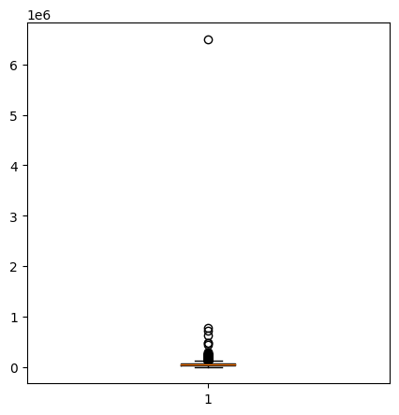
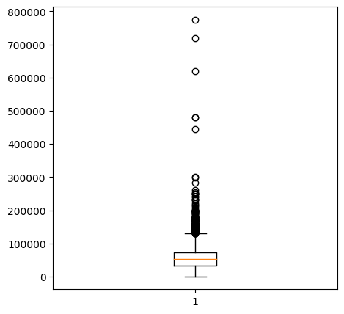
Data Processing
‘Driven’ 이상치 데이터 제거
‘Nan’ 값 갖는 데이터 전부 제거
(자세한 전 처리 과정은 마지막 페이지 증빙자료 참조)

Slide 8
Data Processing
Column명 바꾸고 One-Hot Encoding 한 후 테이블
5872 rows and 57 columns
Year | Driven | Mileage | Engine | Power | Seats | Price | Brand Ambassador | Brand Audi | Brand BMW | Brand Bentley | Brand Chevrolet | Brand Datsun | Brand Fiat | Brand Force | Brand Ford | Brand Honda | …
2010 | 72000 | 43.624 | 998 | 58.16 | 5 | 1.75 | 0 | 0 | 0 | 0 | 0 | 0 | 0 | 0 | 0 | 0 | …
2015 | 41000 | 19.67 | 1582 | 126.2 | 5 | 12.5 | 0 | 0 | 0 | 0 | 0 | 0 | 0 | 0 | 0 | 0 | …

Slide 9
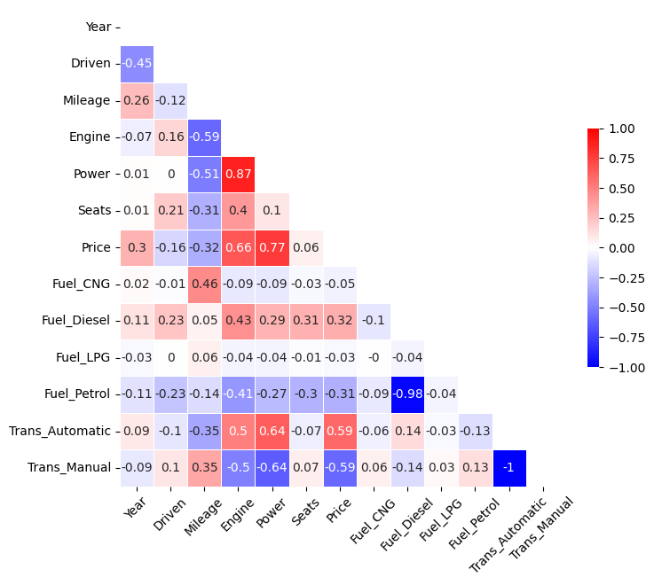
Heat map
주요 변수들만 표시

Slide 10
Machine Learning

Slide 11
Linear Regression
from sklearn.linear_model import LinearRegression, LogisticRegression
from sklearn.model_selection import train_test_split, KFold
from sklearn.metrics import mean_absolute_error, mean_squared_error
from sklearn.metrics import accuracy_score, r2_score, mean_absolute_error
X = df_data.drop('Price', axis = 1)
y = df_data['Price’]
X_train, X_test, y_train, y_test = train_test_split(X, y, test_size = 0.3, random_state = 10)
# X_train.shape, X_test.shape = ((4110, 56), (1762, 56))
# y_train.shape, y_test.shape = ((4110,), (1762,))
lr = LinearRegression()
lr.fit(X_train, y_train)
pred = lr.predict(X_test)
y_train_log = np.log(y_train)
lr.fit(X_train, y_train_log)
new_pred = lr.predict(X_test)
pred_exp = np.exp(new_pred)

Slide 12
Random Forest Regressor
from sklearn.ensemble import RandomForestRegressor
from sklearn.metrics import classification_report, roc_auc_score
from sklearn.model_selection import GridSearchCV
X = df_data.drop('Price', axis = 1)
y = df_data['Price’]
X_train, X_test, y_train, y_test = train_test_split(X, y, test_size = 0.3, random_state = 10)
# X_train.shape, X_test.shape = ((4110, 56), (1762, 56))
# y_train.shape, y_test.shape = ((4110,), (1762,))
rf = RandomForestRegressor()
rf.fit(X_train, y_train)
pred_rf = rf.predict(X_test)
y_train_log = np.log(y_train)
rf.fit(X_train, y_train_log)
new_pred_rf = rf.predict(X_test)
pred_exp_rf = np.exp(new_pred_rf)

Slide 13
Decision Tree
from sklearn.tree import DecisionTreeRegressor
from sklearn.metrics import mean_squared_error
X = df_data.drop('Price', axis = 1)
y = df_data['Price’]
X_train, X_test, y_train, y_test = train_test_split(X, y, test_size = 0.3, random_state = 10)
# X_train.shape, X_test.shape = ((4110, 56), (1762, 56))
# y_train.shape, y_test.shape = ((4110,), (1762,))
dt = DecisionTreeRegressor(random_state = 10)
model = dt.fit(X_train,y_train)
pred_dt = dt.predict(X_test)

Slide 14
Multi-layer Perceptron Regressor
from sklearn.neural_network import MLPRegressor
X = df_data.drop('Price', axis = 1)
y = df_data['Price’]
X_train, X_test, y_train, y_test = train_test_split(X, y, test_size = 0.3, random_state = 10)
# X_train.shape, X_test.shape = ((4110, 56), (1762, 56))
# y_train.shape, y_test.shape = ((4110,), (1762,))
model = MLPRegressor(hidden_layer_sizes=(300, 300), activation = 'relu’,
solver = 'adam', learning_rate = 'constant', learning_rate_init = 0.01,
max_iter = 50, batch_size = 32, shuffle = True, random_state = 10)
model.fit(X_train, y_train)
pred_MLP = model.predict(X_test)

Slide 15
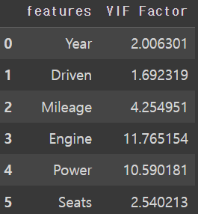
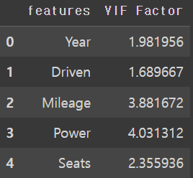
다중 공선성 판단
회귀 분석에서 하나의 feature(예측 변수)가 다른 feature와의 상관 관계가 높으면, 회귀 분석 시 부정적인 영향을 미칠 수 있기 때문에, 모델링 하기 전에 먼저 다중 공선성의 존재 여부를 확인 필요
보통 다중 공선성을 판단할 때 VIF(Variance Inflation Factors)값 이용
일반적으로, VIF > 10인 feature들은 다른 변수와의 상관관계가 높아, 다중 공선성이 존재하는 것으로 판단
‘Engine’ 포함한 데이터로 머신 러닝 대입한 버전: v1
‘Engine’ 없는 데이터로 머신 러닝 대입한 버전: v2
제거

Slide 16
Results

Slide 17
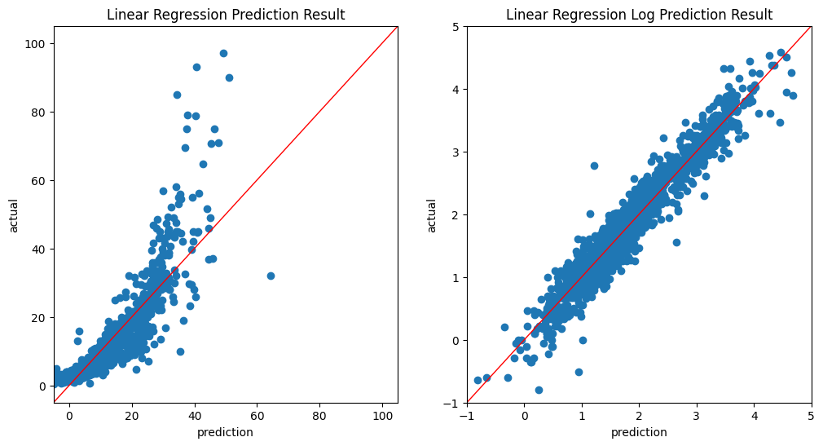
Linear Regression
v1 | Linear Regression | Linear Regression Log
accuracy | 0.7803 | 0.9253
r2 score | 0.7790 | 0.8596
Root Mean Square(rmse) | 5.1974 | 17.1682
v1 | Linear Regression | Linear Regression Log
accuracy | 0.7799 | 0.9249
r2 score | 0.7771 | 0.8551
Root Mean Square(rmse) | 5.2202 | 4.2086

Slide 18
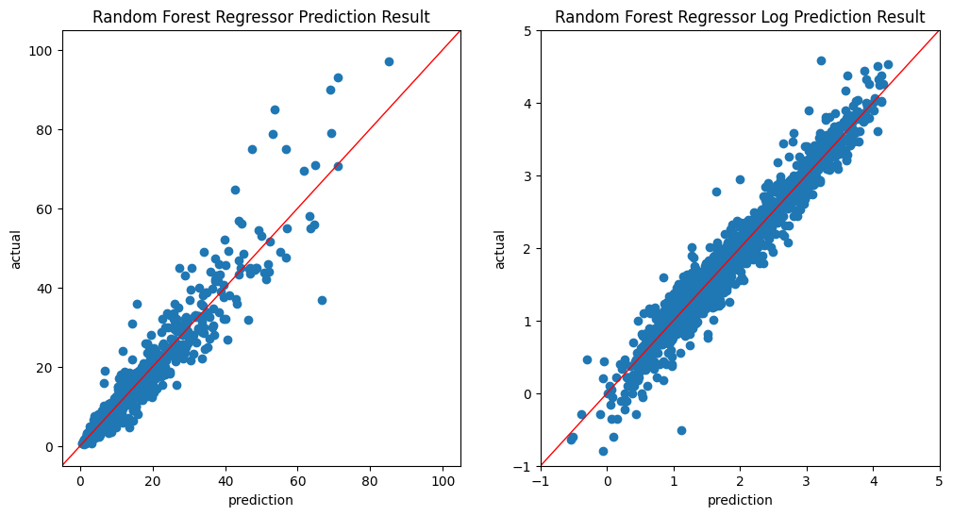
Random Forest Regressor
v1 | Random Forest Regressor | Random Forest Regressor Log
accuracy | 0.9820 | 0.9912
r2 score | 0.9265 | 0.8923
Root Mean Square(rmse) | 2.9959 | 3.6290
v2 | Random Forest Regressor | Random Forest Regressor Log
accuracy | 0.9816 | 0.9912
r2 score | 0.9235 | 0.8945
Root Mean Square(rmse) | 3.0584 | 3.5909

Slide 19
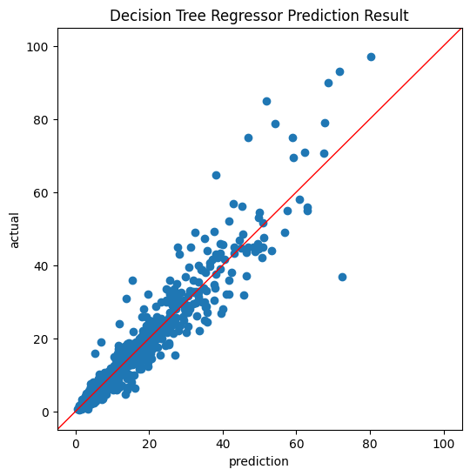
Decision Tree Regressor
 | Decision Tree Regressor
accuracy | 0.9999
r2 score | 0.7712
Root Mean Square(rmse) | 5.2883
 | Decision Tree Regressor
accuracy | 0.9999
r2 score | 0.7385
Root Mean Square(rmse) | 5.6538

Slide 20
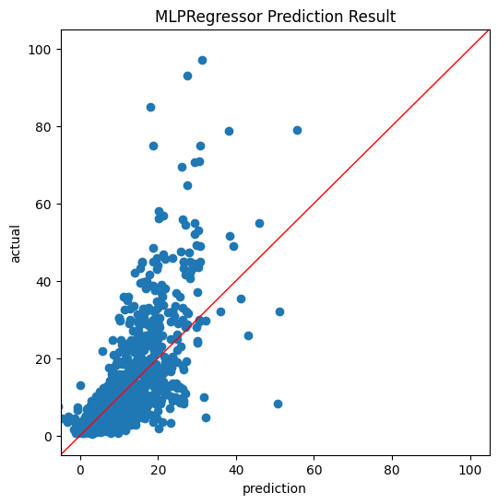
Multi-layer Perceptron Regressor
 | Multi-layer Perceptron Regressor
accuracy | 0.5556
r2 score | 0.5300
Root Mean Square(rmse) | 7.5809
 | Multi-layer Perceptron Regressor
accuracy | 0.6257
r2 score | 0.6286
Root Mean Square(rmse) | 6.7390

Slide 21
Conclusion

Slide 22
Conclusion
제일 결과가 좋은 모델: Random Forest Regressor
이상치 데이터 제거 안하고 선형회귀 분석했을 때: Train data Accuracy < 0
이상치 제거 후 : Train data Accuracy = 0.78
→ 하나의 이상 값으로도 결과에 큰 영향을 미침 (데이터 전처리의 중요성)
같은 데이터로 다른 모델을 사용했을 때 결과 다름
→ 모델 선택의 중요성

Slide 23
증빙 자료
📌Github 주소
https://github.com/sohee4/portfolio
📌Python 코드
https://colab.research.google.com/drive/1ELa_e1JDyCCbJ03bdBFlaLftlxNBeGRE#scrollTo=0KXaWBpXX4tN

